Slide 1






Budget Management System, Budgetify
Presented by Group 3T

Slide 2






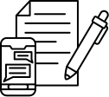

our team
Front-End Developer
Back-End Developer
Content Creator
Teh Hong Kai
Tan Kai Sheng
Tong Yue Luong

Slide 3

Introduction
Budgetify is a simple and friendly tool to help you take control of your spending. Whether you're planning for daily expenses or saving up for something big, Budgetify lets you manage budgets, track spending, and reflect on your progress, all in one place. We designed it to be clean, easy to use, and helpful, so anyone can manage their budgets with confidence.

Slide 4


Background
Problem Statement
Our Solution
In today's fast-paced world, being financially aware and managing our spending wisely is essential for achieving future goals. Unfortunately, many teenagers lack the necessary skills to handle their finances effectively, often due to constant distractions or limited exposure to practical budgeting habits.
Budgetify was made to help teenagers build financial awareness by creating simple budgets, tracking expenses, and reflecting on spending habits for smarter money decisions.

Slide 5


Target Audience
Teenagers and students who are starting to manage their own money.
Many lack budgeting skills and face distractions that affect their spending.
Budgetify helps them track expenses, set limits, and build good money habits early on.

Slide 6


Programming Languages
Front-end
Back-end
We used HTML, CSS, and JavaScript to build the interface. These technologies helped us design a clean layout, interactive features, and responsive design suitable for users on different devices.
We used PHP and MySQL to manage user accounts and store budgeting data. This allow users to save their progress, access data anytime, and enjoy a more personalized experience.

Slide 7
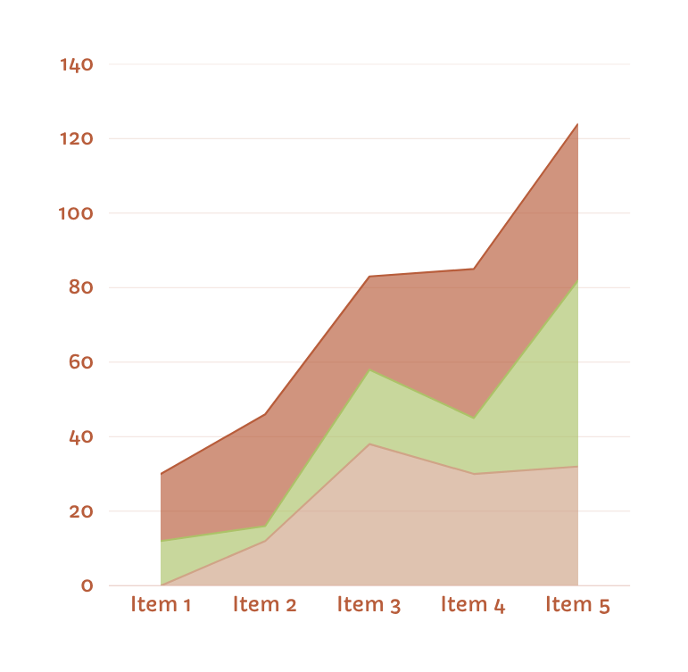


Frameworks & Libraries
We didn’t use major frontend or backend frameworks like React or Laravel, but we did use Google Fonts to improve the site’s typography. We also referred to a draft website given by our mentor as a layout and design guide.

Slide 8

Tools & Technologies
Throughout development, we used Visual Studio Code for coding, Git and GitHub for version control, Canva for design, Discord for team communication, and ChatGPT to assist with grammar, coding, and research.

Slide 9

Key Features
Budgetify helps users manage their money with simple tools for planning budgets, tracking expenses, and reflecting on spending habits. It supports short-term and long-term goals for better financial decisions.
Smart budget planning
Categorized expense tracking
Goal-driven spending management

Slide 10


Future Improvement
Spending Alerts
Customization
Gamification
We plan to add smart alerts that notify users when their budget time ends or spending exceeds limits, helping them stay on track.
Features like leaderboards and user interaction will make budgeting more engaging and goal-driven.
Users will be able to personalise their experience with custom backgrounds, themes, and styles.

Slide 11

conclusion
In conclusion, Budgetify is a simple yet effective budgeting tool designed to help users manage their money with ease. By offering essential features like budget planning, expense tracking, and financial reflection, it encourages better spending habits and goal-focused decisions.

Slide 12

thankyou

